Slide 1
Natural Language Processing (NLP) with SciKit Learn

Slide 2
Learning Objectives
By the end of this lesson, you will be able to:
Define natural language processing
Explain the importance of natural language processing
List the applications using natural language process
Outline the modules to load content and category
Apply feature extraction techniques
Implement the approaches of natural language processing

Slide 3
Natural language processing is an automated way to understand and analyze natural human languages and extract information from such data by applying machine algorithms.
It is also referred to as, the field of computer science or AI to extract the linguistics information from the underlying data.

Slide 4
Why Natural Language Processing
Analyzing tons of data
Identifying various languages
Applying quantitative analysis
Handling ambiguities

Slide 5
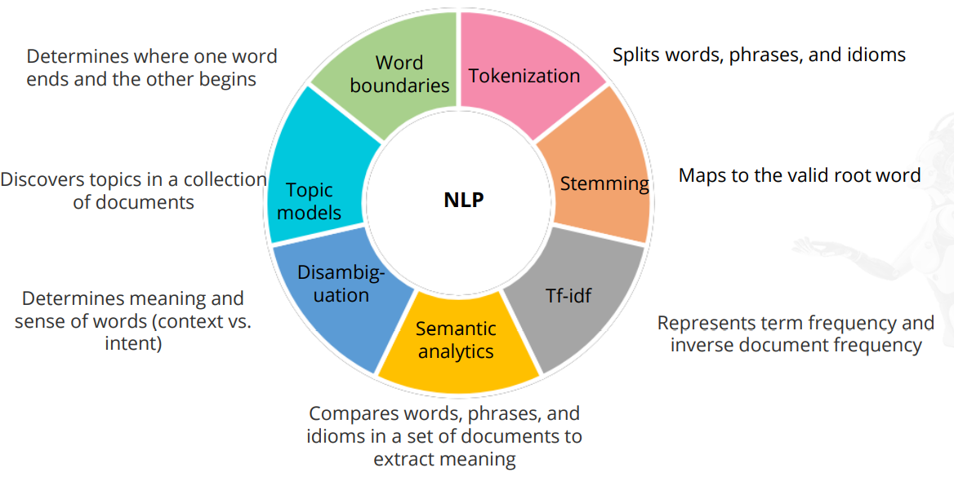
NLP Terminology

Slide 6
NLP Approach for Text Data
Build feature-based structure
Analyze the meaning
Categorize and tag words
Classify text
Extract information
Conduct basic text
Analyze sentence structure

Slide 7

Applications of NLP : Machine Translation
Machine translation is used to translate one language into another. Google Translate is an example. It uses NLP to translate the input data from one language to another

Slide 8

Applications of NLP : Speech Recognition
The speech recognition application understands human speech and uses it as input information. It is useful for applications like Siri, Google Now, and Microsoft Cortana.

Slide 9

Applications of NLP: Sentiment Analysis
Sentiment analysis is achieved by processing tons of data received from different and sources. For example, NLP uses all social media activities to find out the popular topic of discussion or importance.

Slide 10
Major NLP Libraries
NLTK
Scikit-learn
TextBlob
spaCy

Slide 11
The Scikit-Learn Approach
It is a very powerful library with a set of modules to process and analyze natural language data, such as text and images, and extract information using machine learning algorithms.
Built-in module: Contains built-in modules to load the dataset’s content and categories
Feature extraction :A way to extract information from data which can be text or images. For instance, count vectorizer is used to convert a collection of text documents to a vector of token counts
Model training : Analyzes the content based on particular categories and then trains them according to a specific model.

Slide 12
Modules to Load Content and Category
The attributes of a data load object are:
Bunch: Contains fields and can be accessed as dict keys or an object
Target names: Has the list of requested categories
Data: Refers to an attribute in the memory

Slide 13
Bag of Words
Tokenizing: Assign a fixed integer id to each word
Counting: Number of occurrences of each word
Storing: Store as the value feature

Slide 14
Text Feature Extraction Considerations
Sparse: This utility deals with sparse matrix while storing them in memory. Sparse data is commonly noticed when it comes to extracting feature values, especially for large document datasets.
Vectorizer: It implements tokenization and occurrence. Words with minimum two letters get tokenized. We can use the analyzer function to vectorize the text data.
Tf-idf: It is a term weighing utility for term frequency and inverse document frequency. Term frequency indicates the frequency of a particular term in the document. Inverse document frequency is a factor which diminishes the weight of terms that occur frequently.
Decoding: This utility can decode text files if their encoding is specified.

Slide 15
Model Training
An important task in model training is to identify the right model for the given dataset. The choice of model completely depends on the type of dataset.
Supervised: Models predict the outcome of new observations and datasets, and classify documents based on the features and response of a given dataset. Example: Naïve Bayes, SVM, linear regression, K-NN neighbors
Unsupervised: Models identify patterns in the data and extract its structure. They are also used to group documents using clustering algorithms. Example: K-means

Slide 16
Naïve Bayes Classifier
It is the most basic technique for classification of text
Advantages:
• It is efficient as it uses limited CPU and memory.
• It is fast as the model training takes less time.
Functions:
• Naïve Bayes is used for sentiment analysis, email spam detection, categorization of documents, and language detection.
• Multinomial Naïve Bayes is used when multiple occurrences of the words matter.

Slide 17
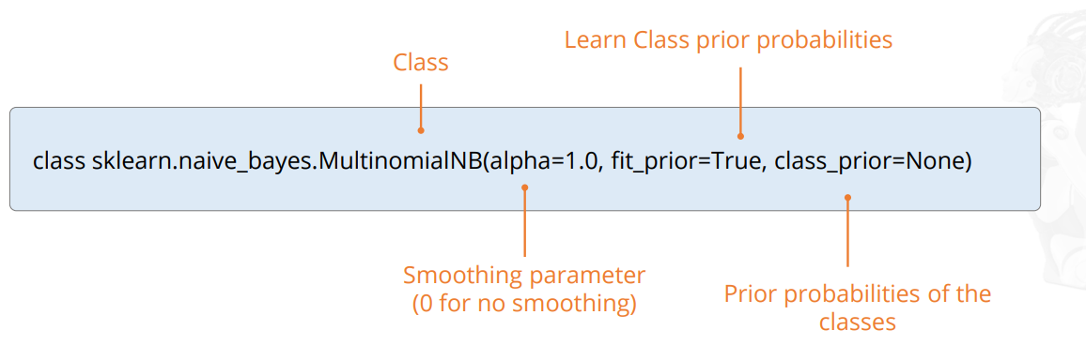
Naïve Bayes Classifier

Slide 18
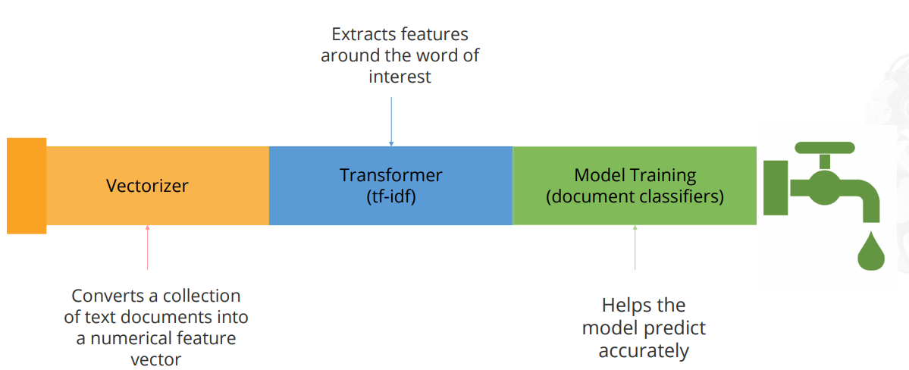
Pipeline
A pipeline is a combination of vectorizers, transformers, and model training.

Slide 19
CHALLENGES OF NLP
There are a number of challenges of natural language processing and mo of them boil down to the fact that natural language is ever-evolving and always somewhat ambiguous. They include:
Precision. Computers traditionally require humans to "speak" to them in a programming language that is precise, unambiguous and highly structured -- or through a limited number of clearly enunciated voice commands. Human speech, however, is not always precise; it is often ambiguous and the linguistic structure can depend on many complex variables, including slang, regional dialects and social context.
Tone of voice and inflection. Natural language processing has not yet been perfected. For example, semantic analysis can still be a challenge. Other difficulties include the fact that the abstract use of language is typically tricky for programs to understand. For instance, natural language processing does not pick up sarcasm easily. These topics usually require understanding the words being used and their context in a conversation. As another example, a sentence can change meaning depending on which word or syllable the speaker puts stress on. NLP algorithms may miss the subtle, but important, tone changes in a person's voice when performing speech recognition. The tone and inflection of speech may also vary between different accents, which can be challenging for an algorithm to parse..

Slide 20
Evolving use of language. Natural language processing is also challenged by the fact that language -- and the way people use it -- is continually changing. Although there are rules to language, none are written in stone, and they are subject to change over time. Hard computational rules that work now may become obsolete as the characteristics of real-world language change over time

Slide 21
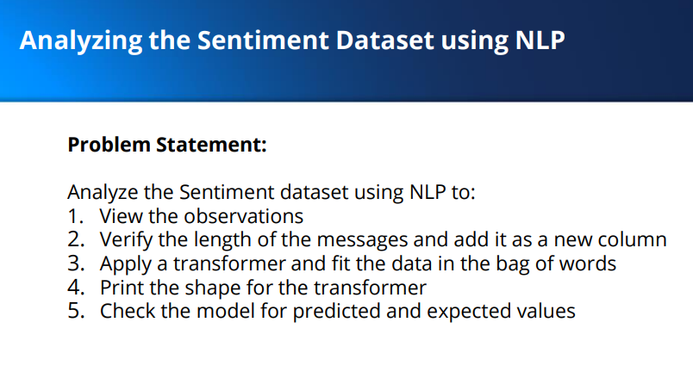
PROJECT 1

Slide 22
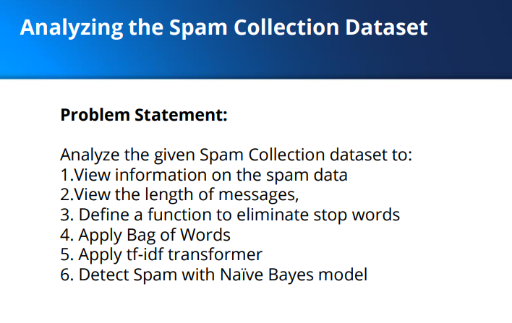
PROJECT 2

